Slide 1






CLASS
HEROES
PROJECT 2
UCb bootcamp team 04-x-force January 28, 2021

Slide 2


User story
Design and create an application
that can be used in a classroom setting that
allows kids to participate more fully through use of comic characters and engage with a teacher.

Slide 3



Slide 4

Project overview

Slide 5

Agenda
Agenda Topics
Divide into groups
Begin researching C.r.u.d
Outline project ideas
Submit Project Proposal for Approval
Initial Design work

Slide 6

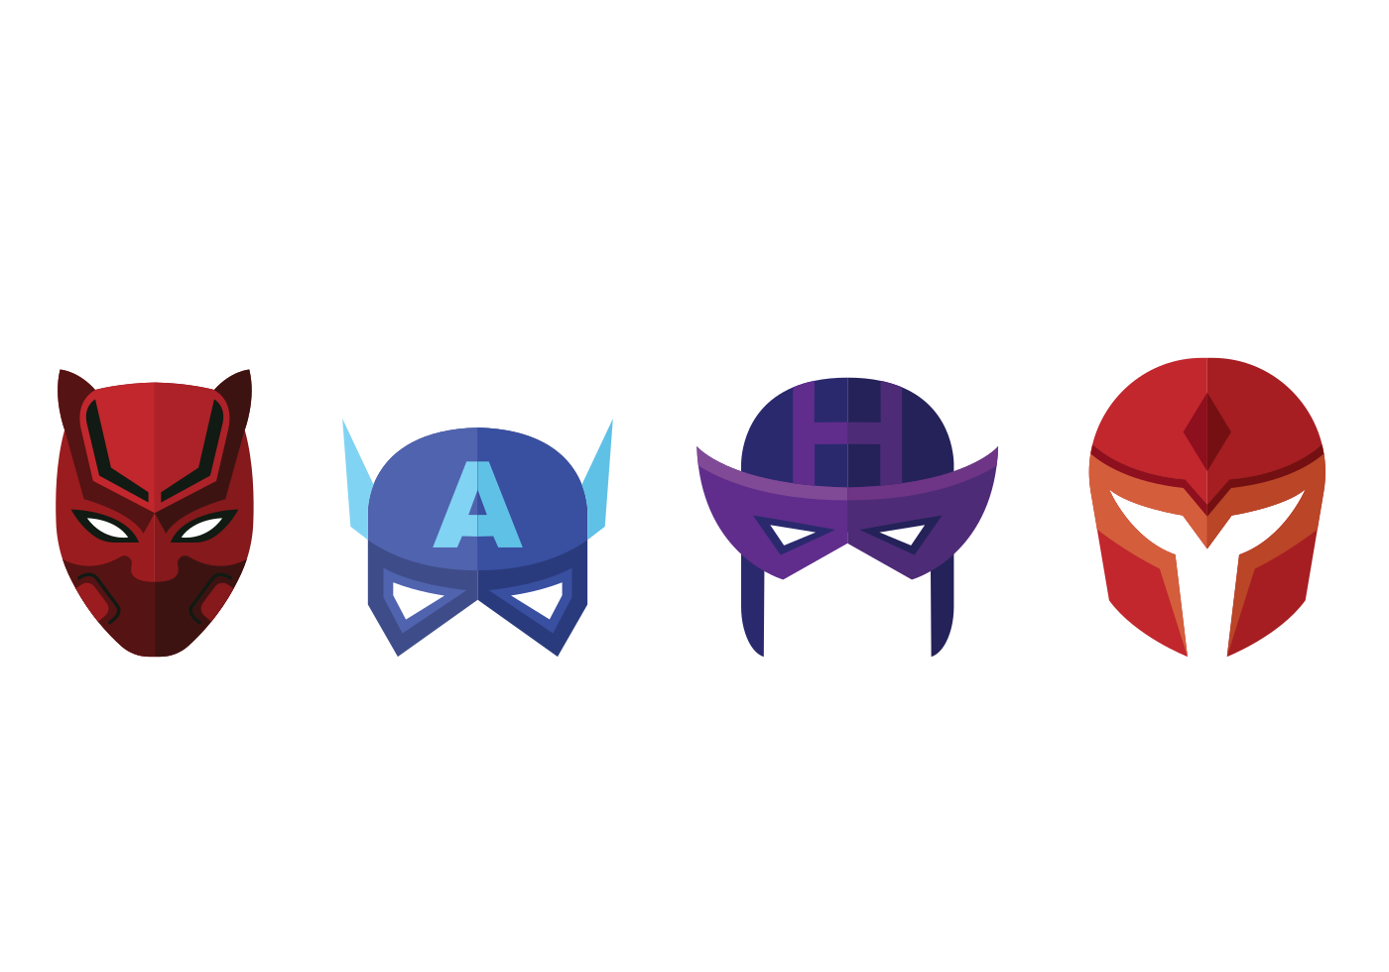
Team 04 X-force !

Slide 7
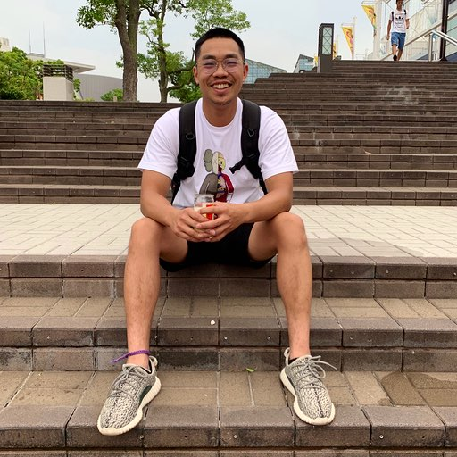

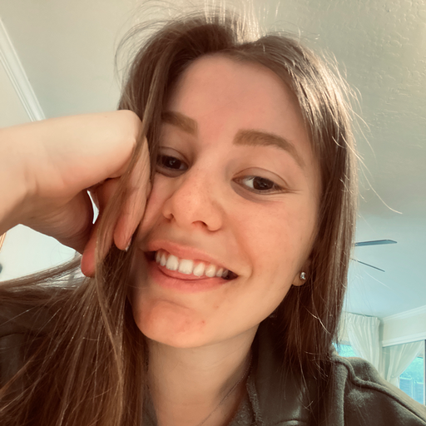

X-force team members
Development lead
Delivery lead
Product lead
Design lead
Victor
tran
Kathleen welch
LEA
Wilhelmer
Christian
Suchoski

Slide 8


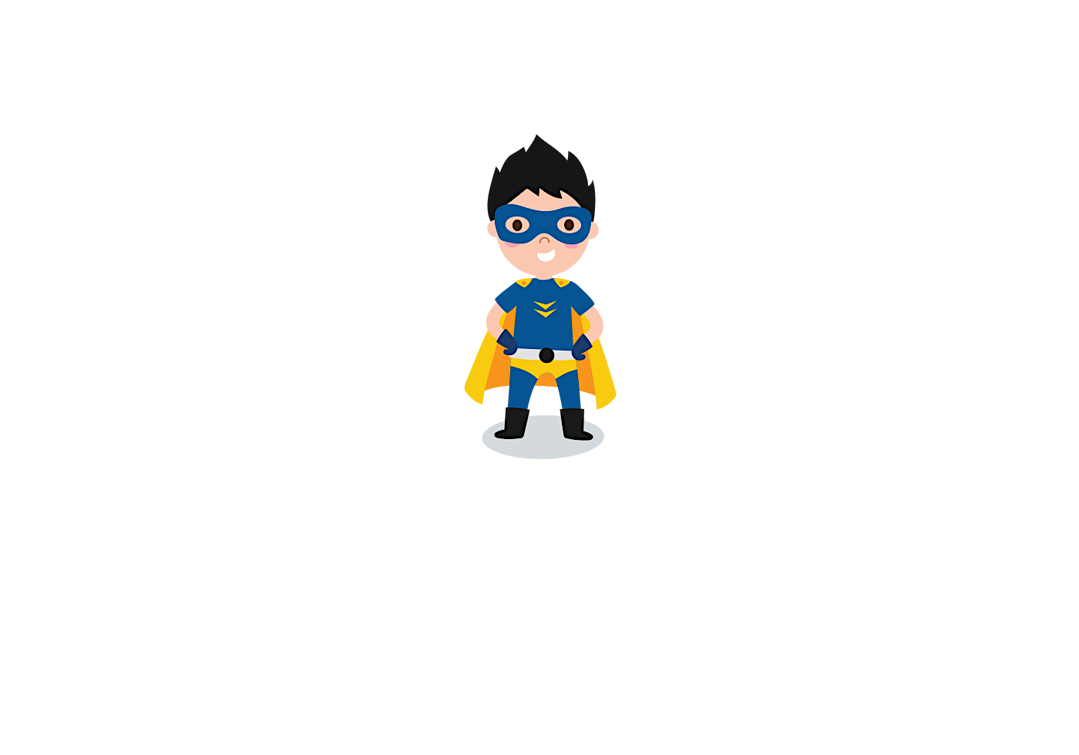
Collaboration time
Lets
brainstorm
team !!!
Brainstorm possible ideas
Begin API Research
Create an initial draft / sketch of the final design
Create a short 1 page proposal listing out each of the following:
Project Title
New Team Name TEAM 04 X-FORCE
Team Members
Project Description
Sketch of Final Product
APIs to be Used
Rough Breakdown of Tasks

Slide 9

TOOLS

Slide 10
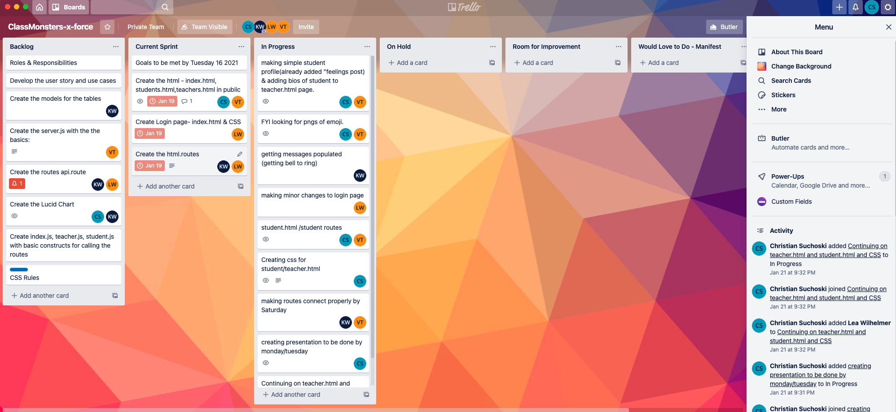
Trello
Trello is a great project management tool for creating to-do lists and communicating updates.

Slide 11
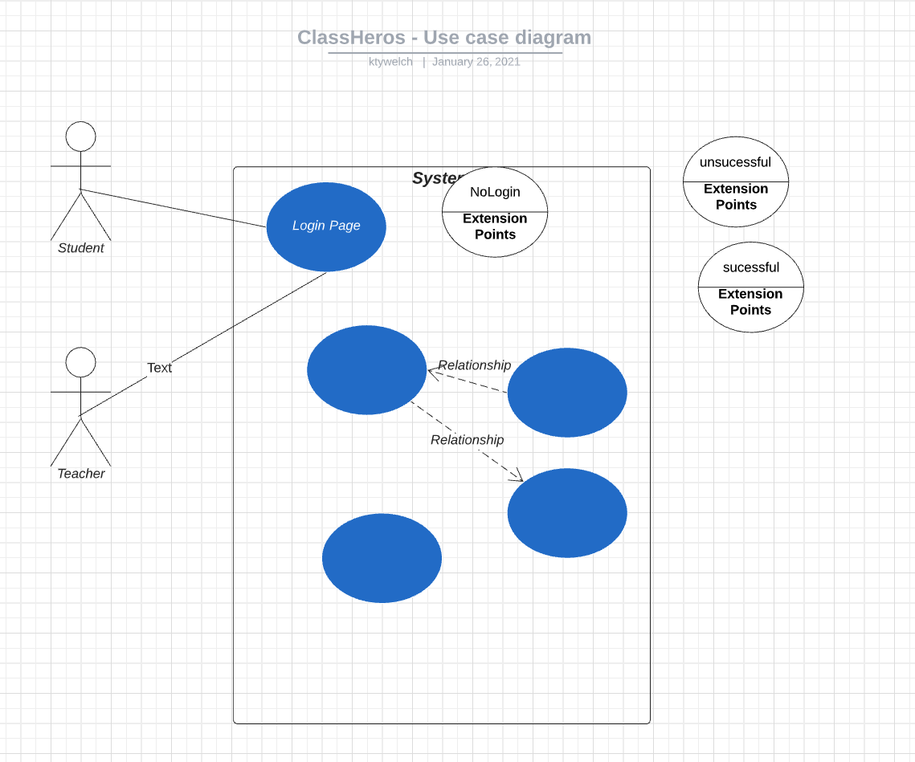
LUCID CHART
Create professional flowcharts, process maps, UML models, org charts, and ER diagrams ...

Slide 12
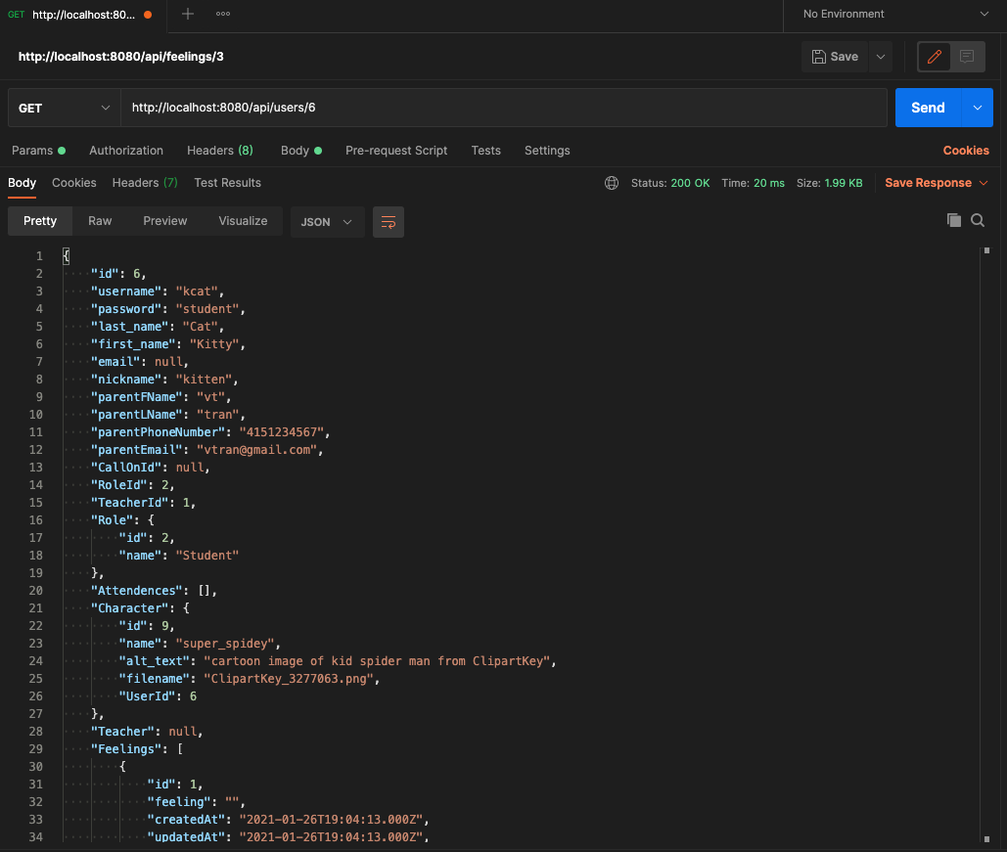
POSTMAN
Simplify each step of building an API and streamline collaboration so you can create better APIs—faster.

Slide 13
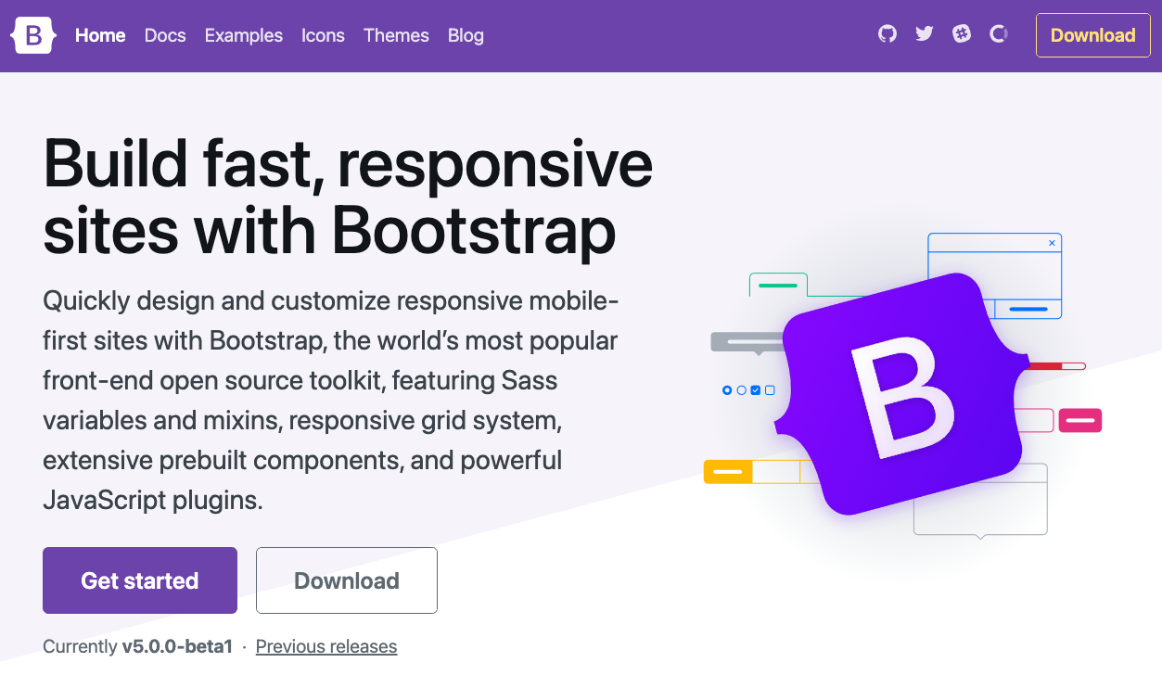
BOOTSTRAP
Bootstrap is a free and open-source CSS framework directed at responsive, mobile-first front-end web development. It contains CSS- and JavaScript-based design templates for typography, forms, buttons, navigation, and other interface components.

Slide 14
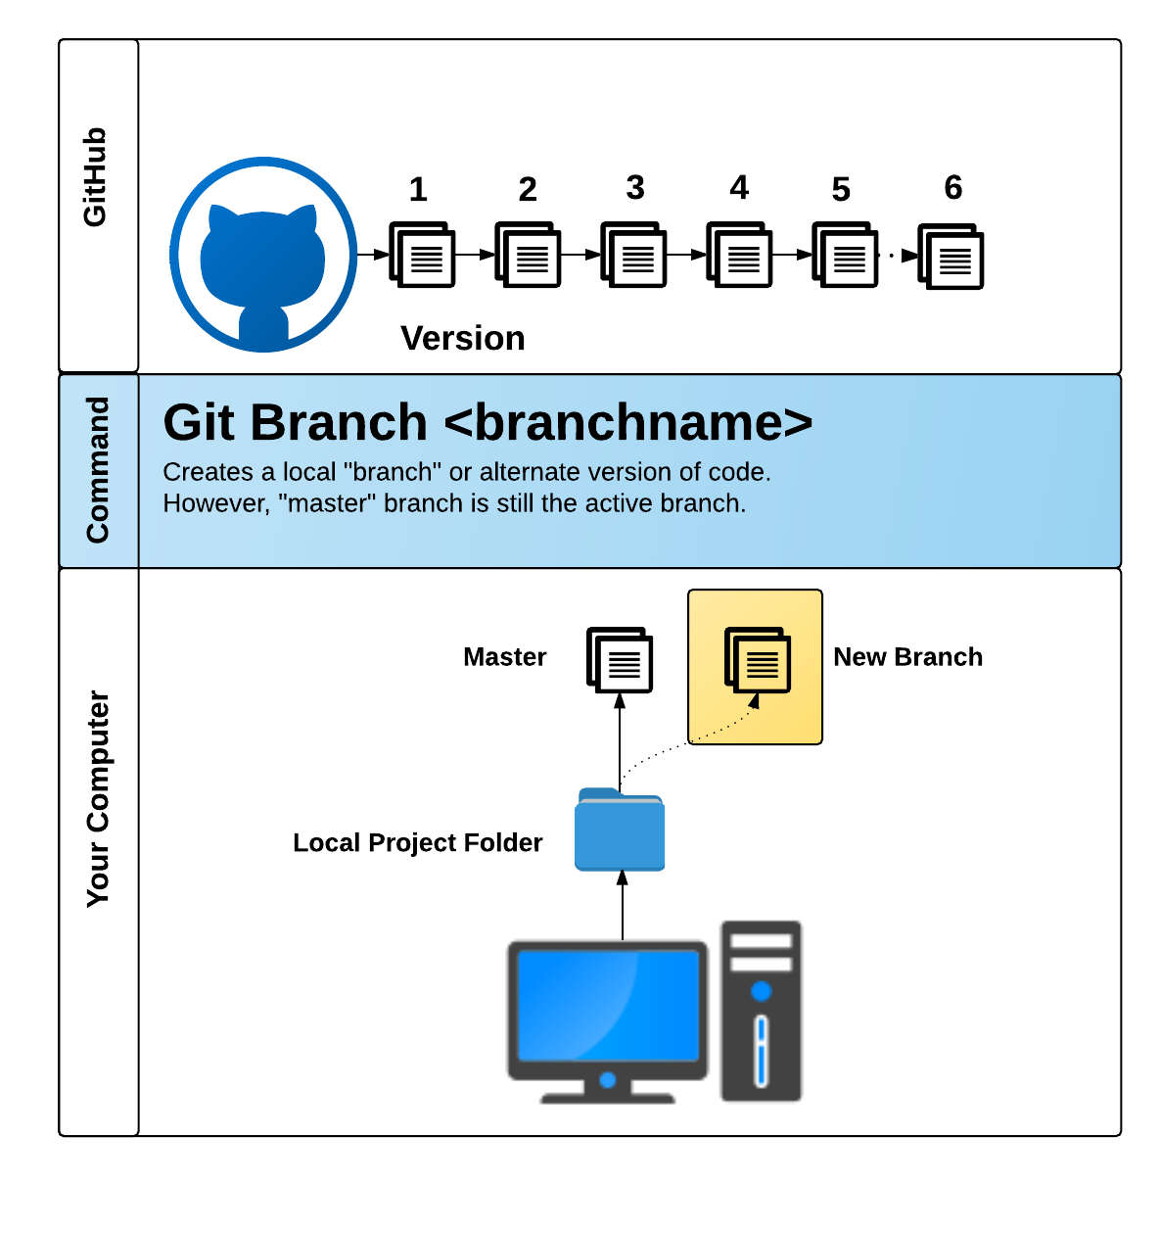
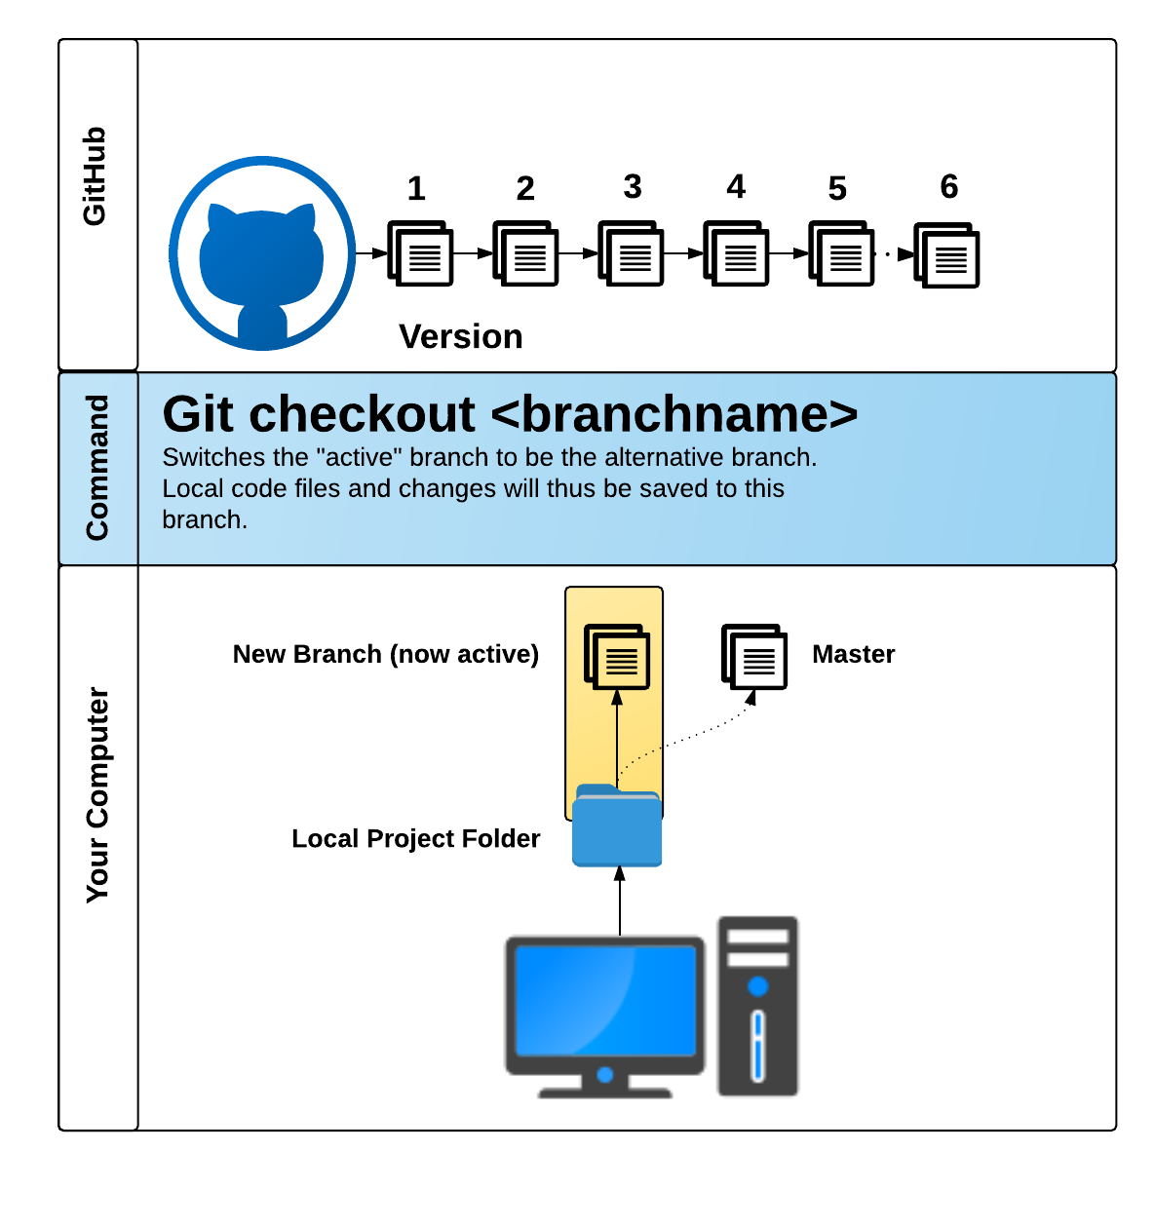
GITHUB PULL REQUEST
GitHub Pull Requests are a great way to combine code when multiple users are working on the same files.

Slide 15
TASK
@ HAND!

Slide 16


Concepts
design
Functionality

Slide 17
CONCEPT
Group brainstorm.
Create and use c.r.u.d functionality within app.
Main focus was to have a simple MVP STUDENT/TEACHER CONNECTION.
Effortless and to the point.
Searched various apps that might use our concept for inspiration.

Slide 18
DESIGN

Slide 19
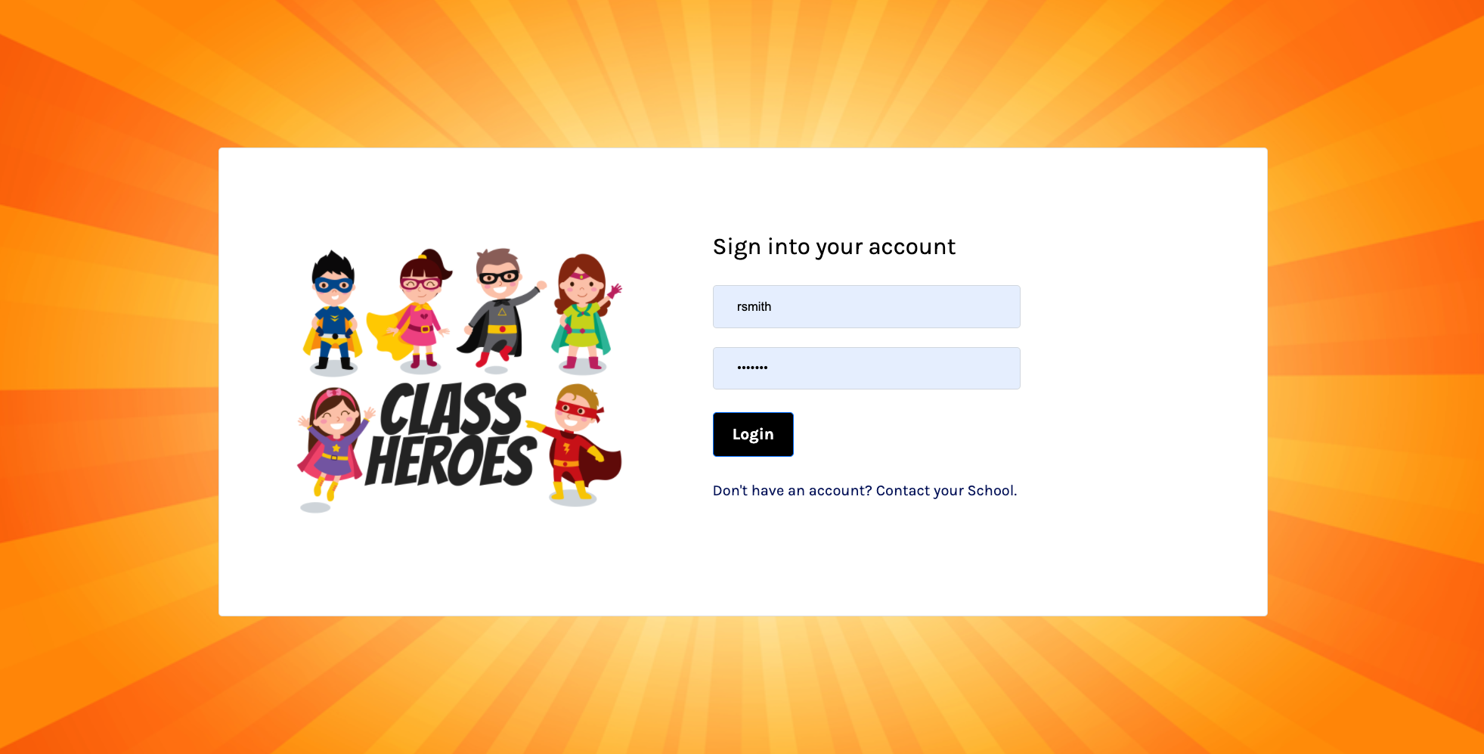
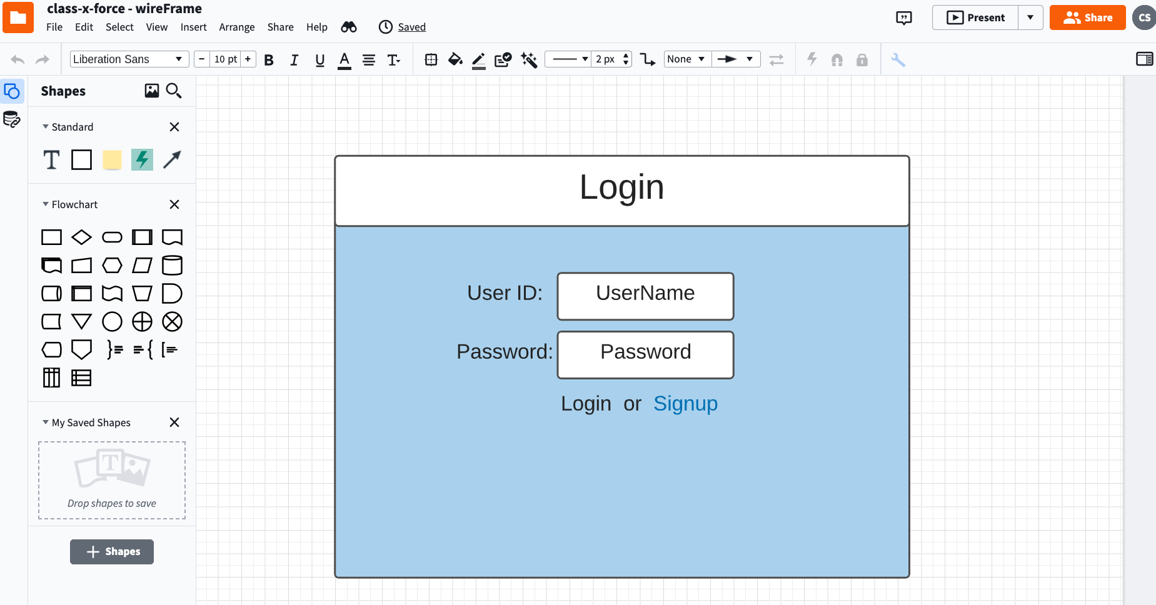
DESIGN

Slide 20






Slide 21
FUNCTIONALITY

Slide 22
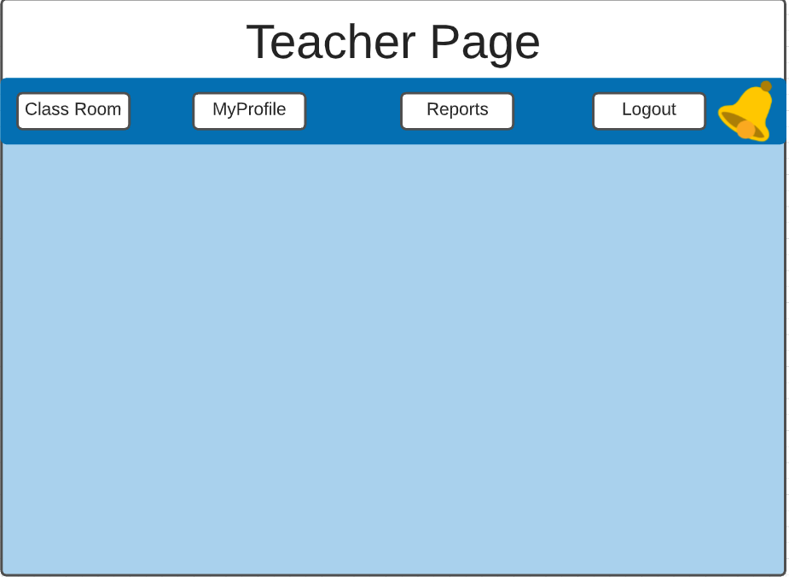
FUNCTIONALITY

Slide 23
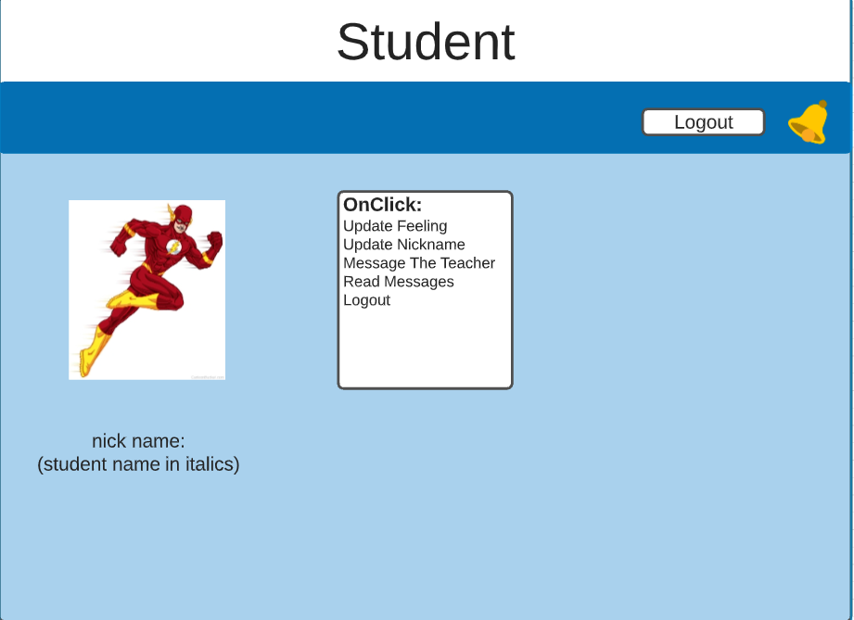
FUNCTIONALITY

Slide 24
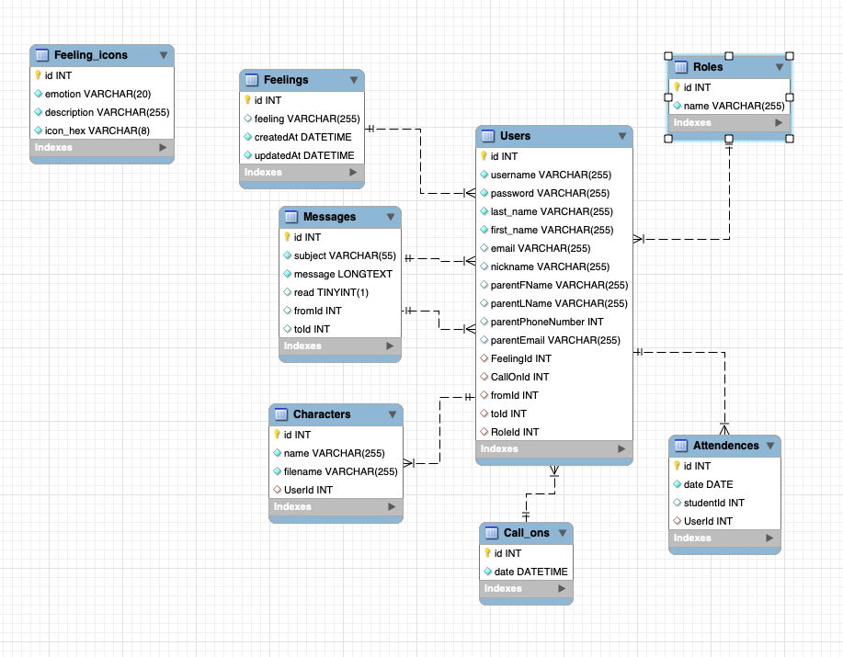
FUNCTIONALITY

Slide 25
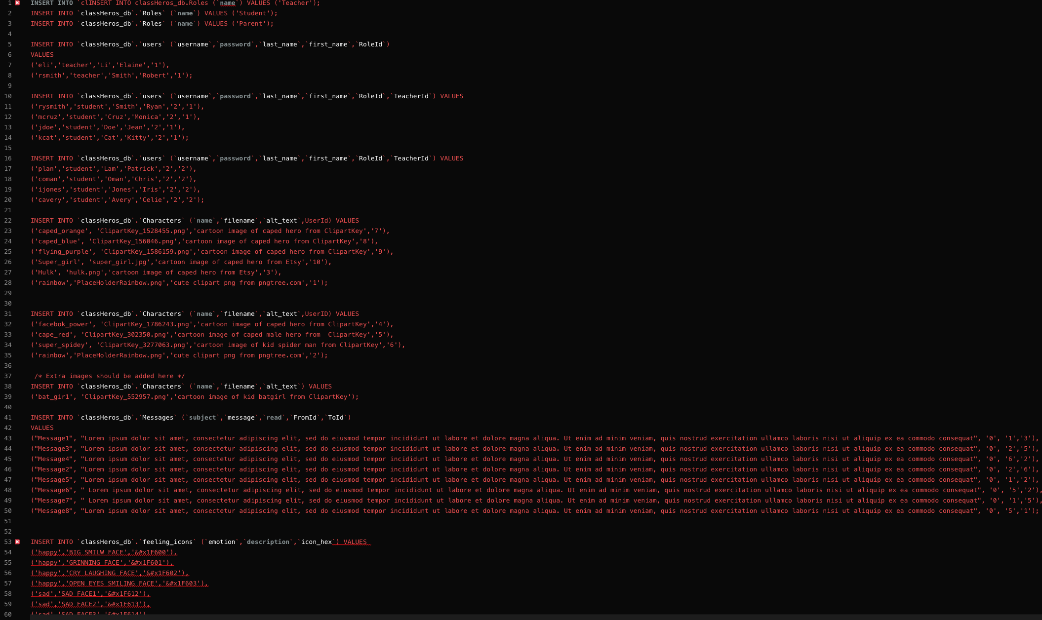
FUNCTIONALITY

Slide 26
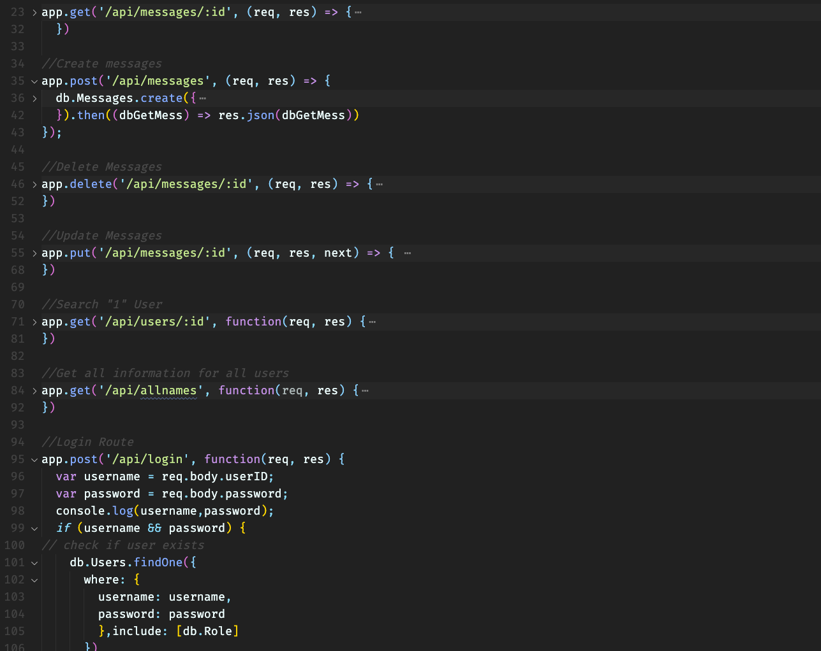
FUNCTIONALITY

Slide 27


FUNCTIONALITY

Slide 28


FUNCTIONALITY

Slide 29


FUNCTIONALITY

Slide 30


Future Development !

Slide 31
Future Development
1. Debug some of our problems and flush out any other issues on the backend.
2. Have teacher be able to generate random student icon to call on thru our application.
3. Create student and teacher chatting within application .
4. Building and enhancing our UI with more notification features.
5. BE able to have student upload pictures and videos of homework.
6. Create qr code for student to hold up to web camera to enter login.
7. A graph charting the feelings of the child over a course of a year
helps teacher or parent address concerns.

